Slide 2
What is the DofE?
The DofE is a life-changing adventure for young
people aged 14-24
It helps young people develop skills for their future life and work
Notes:
Doing their DofE is a brilliant way for your child/young person to discover just how much they are capable of. ​
It gives young people the chance to make new friends, follow their passions, learn new skills and make a difference in their community.
Gaining a DofE Award is a great way to impress future employers too. ​
It’s also non-competitive and a powerful way for every young person to build belief in themselves, whatever their background, interests and abilities. ​
​
​
​

Slide 3
Introducing the DofE
Notes:
The following film provides an overview of the Duke of Edinburgh's Award. ​

Slide 4
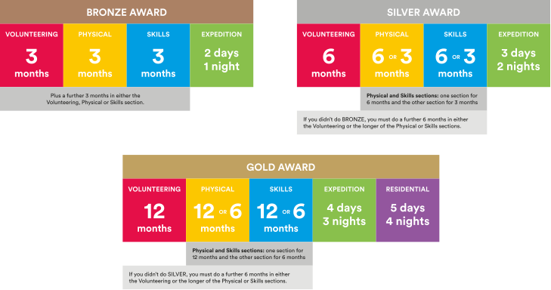
What is involved?
Notes:
There are three levels of DofE Award – Bronze, Silver and Gold. To achieve their Award, your child will need to complete four sections – Volunteering, Physical, Skills and Expedition (add residential for Gold). ​
​The length of time they will need to devote to each section will vary, depending on whether they are at Bronze, Silver or Gold level.​
Choosing which activities to do for each section may seem daunting for your young people. But it’s important to remember that most activities can count.
Many young people will already take part in activities which can be counted towards their DofE Award, and there are a huge number of activities on offer for young people who are keen to try something new.​
​It is important to make sure that the young people are keeping a record of the time they spend on each activity. They may need your support to find an assessor for each section.
Assessors are people who check that activities have been completed and describe the progress that has been made. An assessor should be somebody who has a good understanding of the chosen activity. It can be anyone apart from members of your family.​
​I will now describe each section of the award in more detail.​
​

Slide 5
Volunteering section
Helping others and making a difference to the causes they care about
Notes:
Every young person who pursues a DofE award will be asked to devote some time to volunteering.​
​
Through volunteering, young people have the opportunity to give up their time to help others or to make a difference to causes they feel passionate about.​
As well as changing things for the better, volunteering can be incredibly rewarding for young people – growing their confidence and sense of independence and gaining new skills they can use in their future lives and careers.​
​Examples of volunteering could be coaching a local football team, collecting items for a foodbank or campaigning for change on issues they feel passionate about.
Presenter: Feel free to use examples of previous participants here.
​The amount of time young people will need to volunteer for will vary depending on whether they are pursuing a Bronze, Silver or Gold Award. ​
​Young people can choose to volunteer in any area they would like – the only rule is that young people must not be replacing paid labour, for example by volunteering for commercial organisations.​
​

Slide 6
Physical section
Improving their health and fitness and having fun along the way!
Notes:
A key component of any DofE Award is the Physical section, through which young people are encouraged to take part in regular physical activity. ​
​We know that regular physical activity improves young people’s physical and mental health so is a great habit to acquire when still young.​
​Almost any dance, sport or fitness activity can count – it’s completely up to them which activities they choose, including whether they seek to join a team or choose to do an activity on their own.​
​Completing the Physical section might be the push needed for a young person to try something completely different, or to concentrate and improve on something they are already doing. ​
​
​

Slide 7
Skills section
Developing existing skills or discovering new things to love
Notes:
Through the skills section, young people are encouraged to develop a set of practical and social skills.​
​They will be able to choose whether to develop their skills in areas where they have an existing passion, or to learn about something new.​
In the past, young people have used their skills section to develop their interests and talents in a huge range of areas including computer coding, driving and cooking
Presenter: please add in your own examples here.
​Through gaining interests and talents, young people will enjoy themselves and feel a real sense of achievement.​
​They’ll grow their confidence and show they’re committed, motivated and can rise to a challenge.​
​
​

Slide 8
Expedition
Spending time in the great
outdoors and creating
lifelong memories
Notes:
Young people taking part in a DofE Award will take part in an Expedition.​
​As part of a small team, they will plan their aim, choose their location, do some training to make sure they're prepared and know what they are doing.​
​The amount of time the young people spend away depends on the level of the award they are doing – it will be a minimum of 1 night for Bronze, 2 nights for Silver and 3 nights for Gold.​
​They can choose how they want to travel – it doesn’t have to be on foot. They could do it by bike, canoe, kayak, wheelchair, sailing boat or even on a horse.​
​The expedition is an incredible experience which will help your young person develop resilience, communication, teamwork and leadership skills. ​
​
​

Slide 9
Residential
(Gold Award only)
Five days and four nights away from home
Sharing experiences and creating new connections
Notes:
Presenter: Only use this slide if you are presenting to parents/carers of prospective gold award participants.
​To achieve the Gold Award, there is an extra section – the Residential. ​
​It’s a big, exciting and fulfilling experience as young people spend time in a new place and with people they have never met before​.
​From learning to snowboard in Scotland to helping at a children’s camp, there are lots of exciting possibilities to get involved with — both in the UK and abroad. ​
​Through completing their residential, young people will learn how to work with people from different backgrounds and build confidence staying in new environments. ​

Slide 10
Your role
Guidance
Encouragement
Practical support
Recognising achievement
Notes:
There are several ways you can help your young person to achieve their DofE Award.​
​You should provide guidance and advice – support them with things like choosing their activities and finding assessors.
Encouragement - It can be challenging to keep the motivation going, especially over some of the longer timeframes.​
​If they need it, help keep them on track with their activities, particularly those which are being done from home.​
​Practical support - You may be required to drop off/collect from expeditions and activities, make sure they have all the right kit and also wash the kit when it comes home! ​
​Recognising achievement - We hope all organisations will recognise the amazing achievement, and it is just as important to receive that recognition from family members. ​
​

Slide 11
Your Welcome Pack and eDofE
Notes:
Once your child/young person has signed up to do their DofE, they’ll get their own eDofE account. This will help them to plan their activities online and using the free DofE app. ​
​Participants can use the DofE app to plan activities, get approval from Leaders, record evidence, submit programmes for completion and more.​
​They will also receive a Welcome Pack in the post which contains a wide range of information and advice as well as some more information for parents/carers. ​
​All participants will also be sent a personalised DofE Card to give them and their families discounts at several recommended retailers. Young people at Gold Award level will also be eligible for a discount on their car insurance.​
​

Slide 12
Getting started
Are you ready to support your
child/young person to start an adventure they’ll never forget?
To get started speak to
Mr Lambert
Mr Lambert
DofE Manager
In this bit goes some words you’ve written about yourself. Be positive and tell us who you are? What you’ve done... though don’t tell us your A Level results, there’s plenty of other forms for that. And what excites you about the DofE. You can go on for quite a bit... well, as long as it ﬁlls this box and then suddenly your words will get cut off, even if you’re in the middle of
The DofE is a charity. Visit DofE.org for more information.
Notes:
Presenter: Please customise this slide with the contact details of your DofE leader/administrator.
​Outline the next steps for parents:​
​Check the school / organisation’s process for signing up to DofE.​
​Parents / carers will need to complete and return some paperwork and payment.​
​Start a conversation with your young person about what activities they might choose for their DofE.​

